Slide 1
A universe of literature
Helen Dougherty

Slide 2
The idea

Slide 3
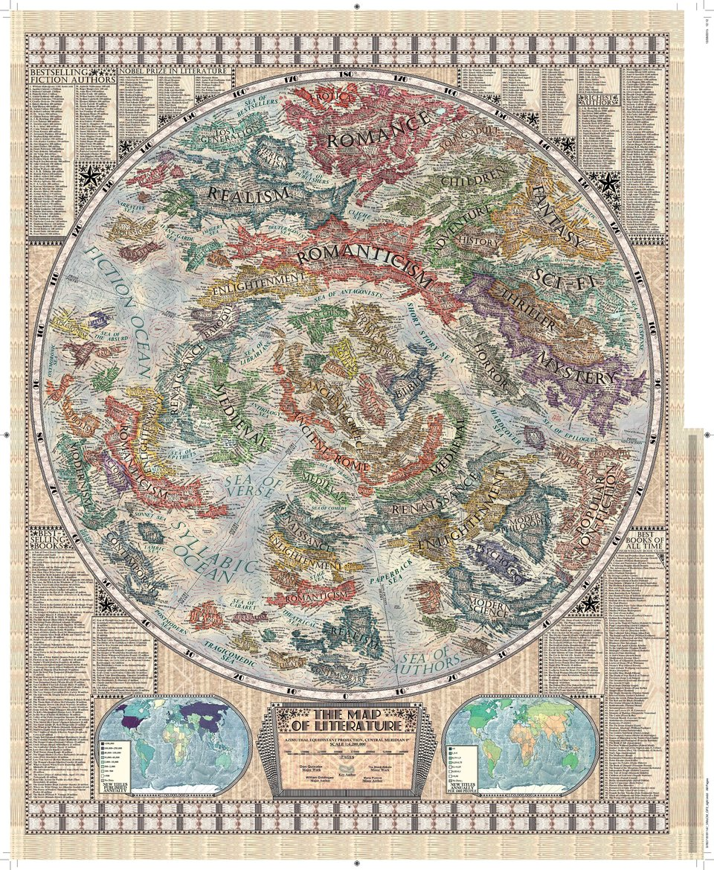
The concept
People often speak of “being transported to other worlds” when talking about why they enjoy reading, and the genres and categorization within literature lends itself fairly easily to items such as political maps
For a 3D environment such as virtual reality: a universe

Slide 4
A universe of literature
Virtual Reality – as with other 3D environments – lends itself well to exploring a space
Can wander around, view both the larger picture and individual details
VR especially lends itself to exploring vast spaces – such as space – without requiring the same physical resources of an actual model
In addition, the “open world” of VR allows for creative license to be taken in ways which may not be possible in the physical world.

Slide 5
A universe of literature
The first, and most obvious, separation: fiction and non-fiction galaxies
The broadest categorization possible
Fiction Galaxy:
Science Fiction and Fantasy: a binary star system
The two are grouped together constantly
Nice “twin suns of Tatooine” reference as well
Mystery, Thriller, and Suspense: a planetary system (likely around one star, given the heavy overlap between the genres) near the Nebula of Horrors
Horror: a dark nebula encroaching on the planetary system of mystery/thriller/suspense
Romance: another nebula, brightly colored and with sparkles

Slide 6
A universe of Literature
Fiction Galaxy, cont.
Classic literature: the Pillars of Creation. Each pillar is topped with the bust of a classic author. Shakespeare must naturally be included. Another should be from Greek or Roman literature (perhaps Virgil or Homer). The third could be Miguel de Cervantes or, perhaps, Geoffrey Chaucer (though English literature is already represented via Shakespeare)
Paranormal: a rogue planet careening through space without a star around which to revolve, content to frighten hapless strangers and incite debate over its very existence
Comics/Manga/Graphic Novels: planetary systems within a star cluster
Close to each other but not actually within the same system as their neighbors
Historical Fiction, LGBT Fiction, Contemporary Fiction, “Women’s Fiction”, related genres: planetary systems within a separate star cluster. Each genre is characterized by a solid grounding in reality (either contemporary or historical), but thematic differences between them prevent placing them within the same system.

Slide 7
A universe of literature
Nonfiction Galaxy
Biography, Autobiography, and Memoir: planetary system(s) within the larger History star cluster.
Have been debating placing individual works around stars representing the relevant historical era – a biography of Shakespeare would revolve around a different star than one of George Washington, for example.
True crime: another planetary system within the History Cluster
See above for debate about placing planets within the History Cluster
Travel: a system near (but not in) the History Cluster
Music and Art: a multi-star system (to represent different art forms)
Or perhaps a single-star system with planets representing different art forms
Philosophy, Religion, and Spirituality: a nebula (perhaps with planets within)
Business: a planetary system
Psychology and Self-Help: a planetary system between Philosophy’s nebula and the Business System

Slide 8
The execution

Slide 9
Planets
In the case of systems with planets, most or all planets represent “seminal” or “canonical” works within the genre
Acclaimed works, works with a significant impact on the rest of the genre, etc.
Sci-Fi/Fantasy, for example, almost has to include Lord of the Rings given its influence on modern fantasy
Star Wars is included for much the same reason, even though its original media was the cinema.
Part of the challenge: choosing such works to represent as planets
Lists of “seminal” works are, at best, subject to personal opinions of the author

Slide 10
Modelling
I decided upon a papercraft/low-poly theme for two reasons:
Avoid getting bogged down in the details of realism
Allow objects to be modelled at whimsical scales, especially in the case of individual features on planets
Challenge: once a novel has been chosen as “seminal”, how to best represent the novel visually using a planet as a canvas?
Pare down elements to the core representation - keep them recognizable but not “realistic”

Slide 11
Challenge
How to represent a written work visually on a planet?
In some cases, as with Lord of the Rings, this is relatively easy
Barad-dûr and the Orthanc (the “two towers” of the second book) are more or less instantly recognizable thanks to Peter Jackson’s trilogy
But should otherwise “seminal” works be discarded because there is no obvious way to visually evoke the novel?
Frankenstein has neither an instantly-recognizable geographic feature or landmark nor an internationally popular movie adaptation to reference – but Mary Shelley arguably created the genre of science fiction with her novel

Slide 12
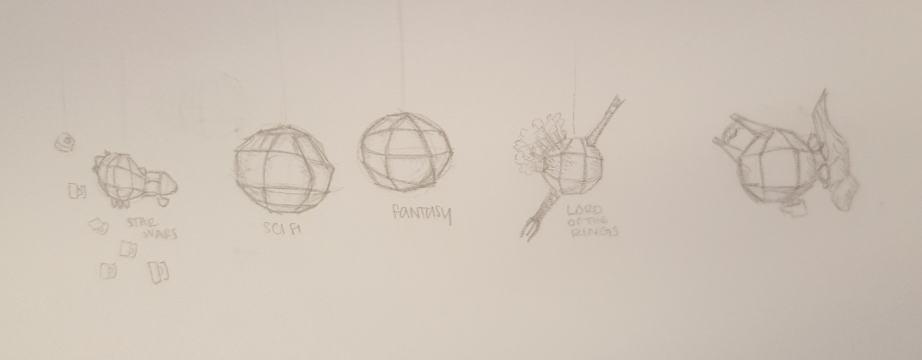

Slide 13
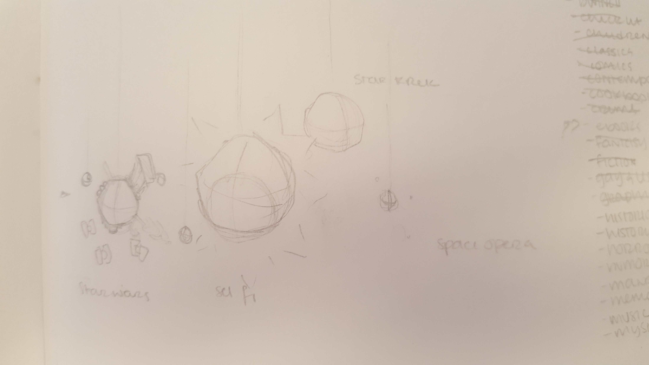
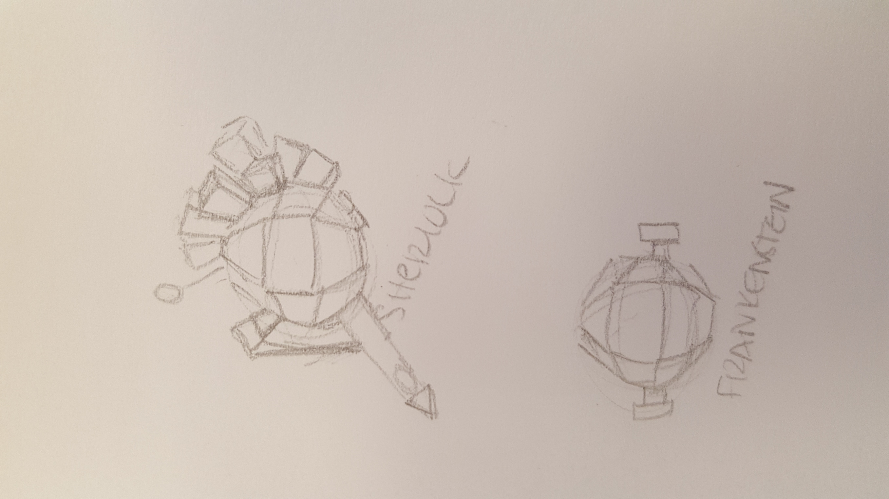

Slide 14
The project

Slide 15
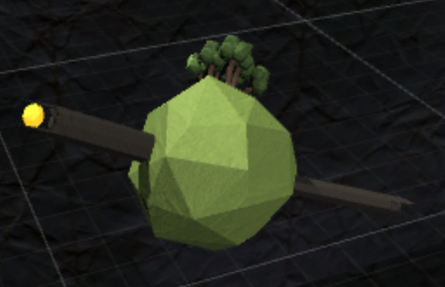
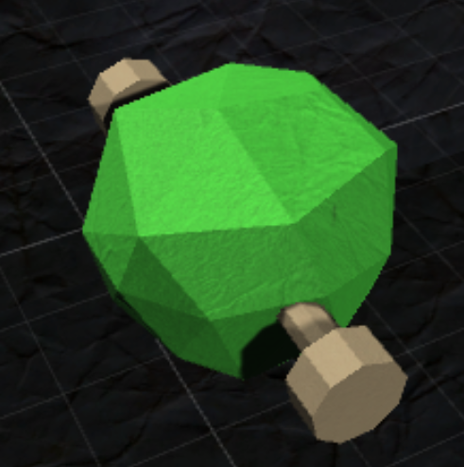
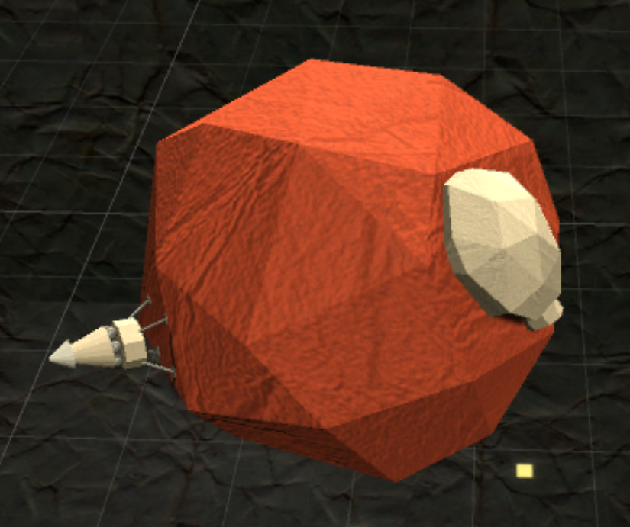
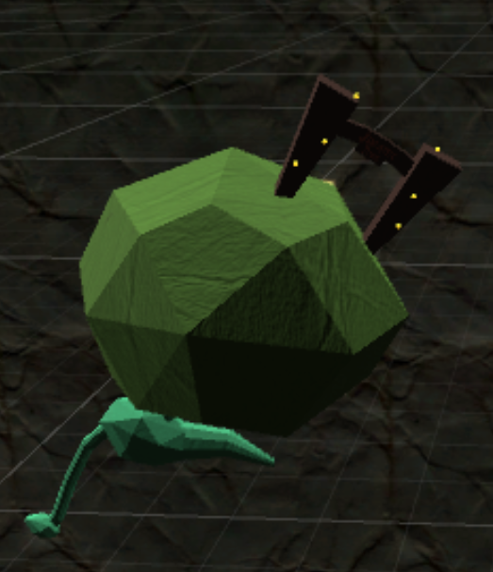
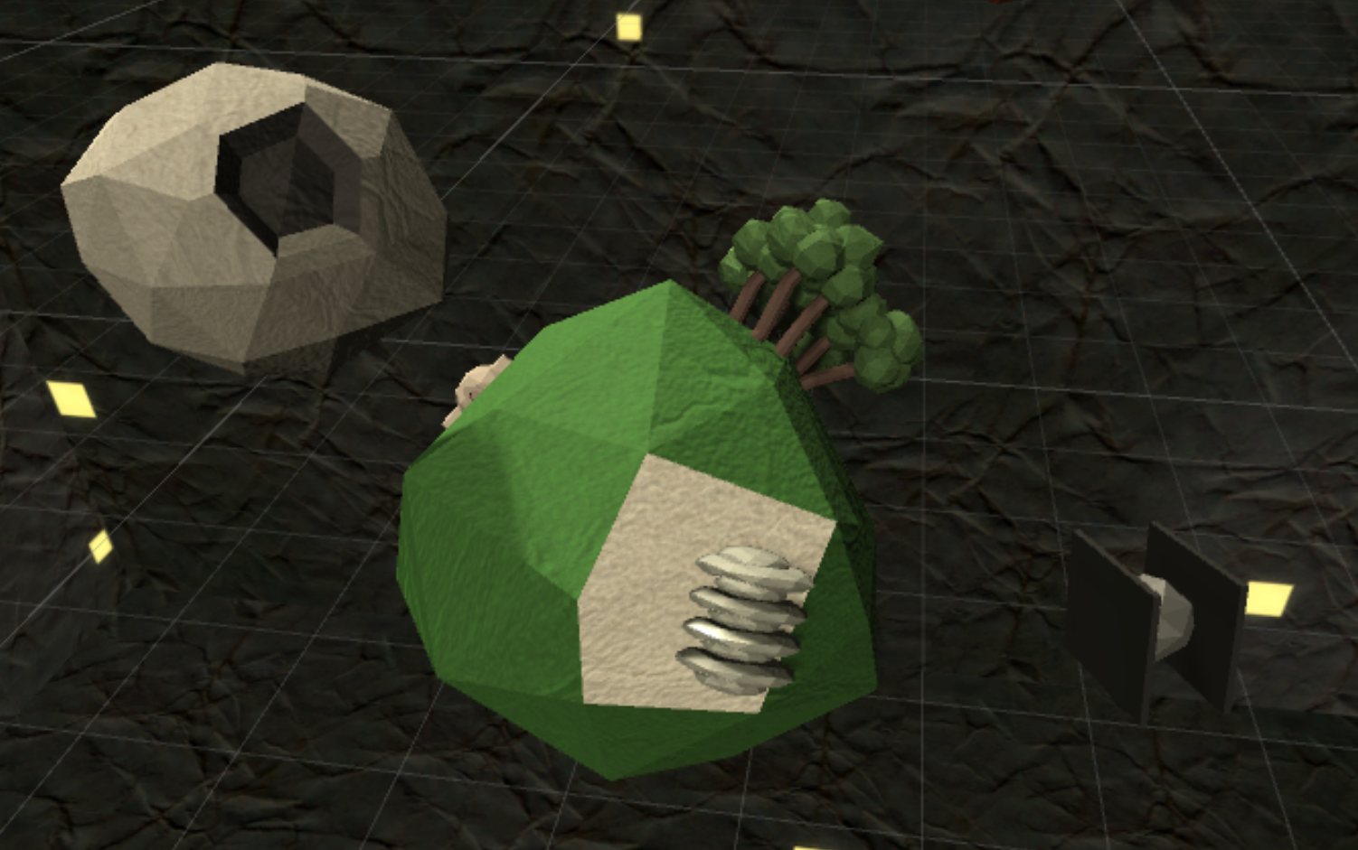

Slide 16
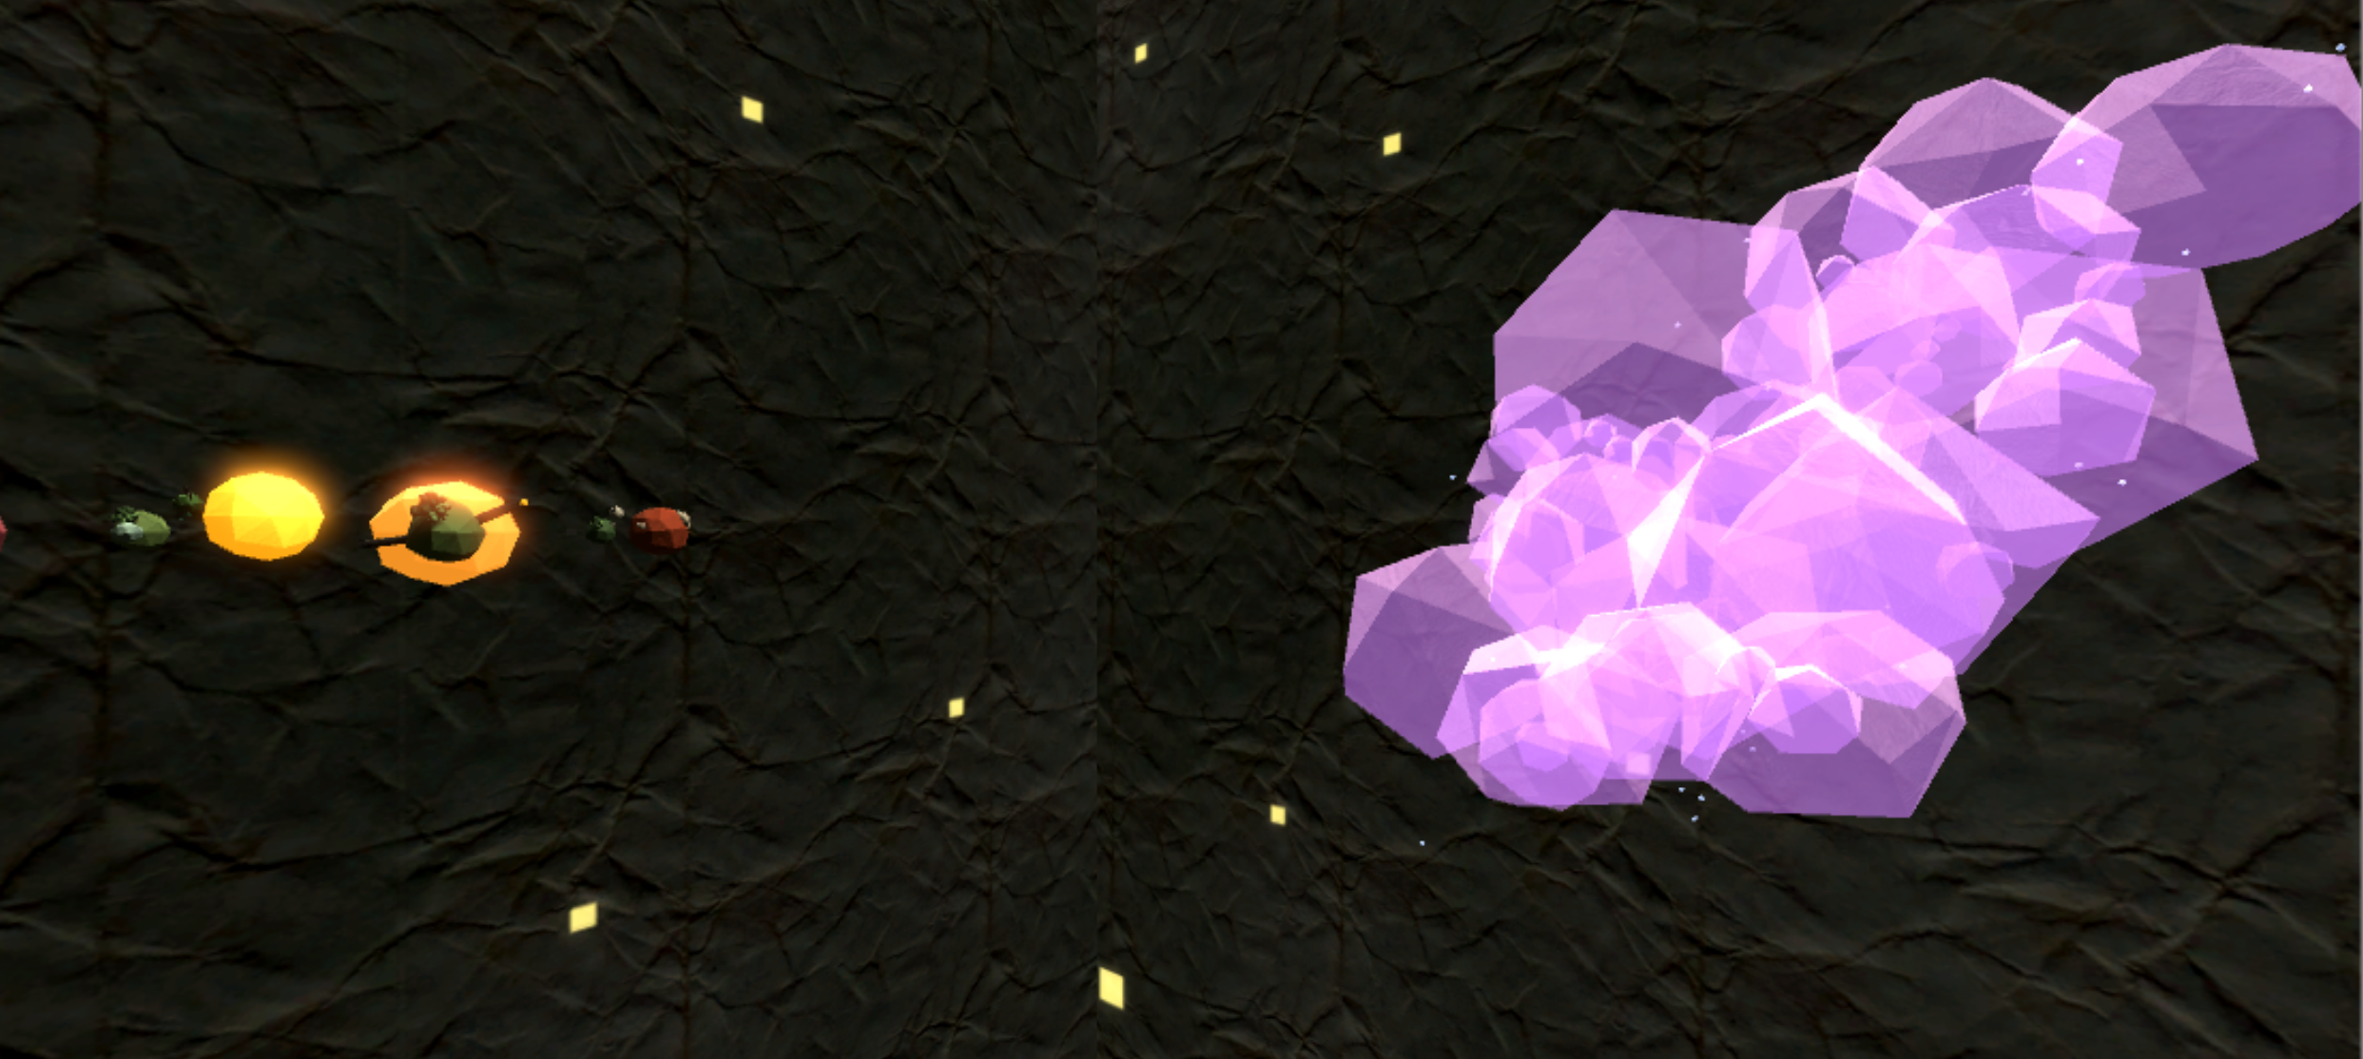

Slide 17
Additional work
Right now, have finished the Nebula of Romance and the Sci-fi/Fantasy binary system
Other genres obviously need to be included
Additional unlisted genres might be added, either for completeness, to guarantee the inclusion of certain influential works, or to add a touch of whimsy to the scene
Example: The Black Hole of Fan Fiction
Fanworks do often have an influence on their source material and because many established authors began by writing fan fiction
And really, it is a black hole, with unknown depths and features from which one may never return
A more serious example: children’s and young adult fiction
Both genres are not strictly genres, but there is no doubt that a work such as Harry Potter is working off a much different literary tradition than A Song of Ice and Fire (or even Jim Butcher’s Dresden Files series)
Another serious example: how to deal with crossover fiction?
The Dresden Files, while perhaps not seminal, represents both the “detective noir” mystery and the “urban fantasy” story
if such a story is included, where should it be placed? Sci-fi/fantasy? Or Mystery/thriller?

Slide 18
The Finished work
The finished project would have all genres represented as their respective astronomical object/system; planetary systems would be populated by those works I, through research, my own opinions, and the assistance and input of others, decided were “seminal” within their genre
The finished project would either consist of one huge scene encompassing both the fiction and non-fiction galaxies or of 2 scenes with a transitional point between the galaxies
A wormhole might be appropriate

Slide 19
sources/references
Music: “Comets and Sparks” by Sergey Cheremisinov. Posted on freemusicarchive.org under an attribution/non-commercial Creative Commons License (http://freemusicarchive.org/music/Sergey_Cheremisinov/Hibernation_1316/Sergey_Cheremisinov_-_Hibernation_-_02_Comets_and_Sparks)
Reference images for the Orthanc and Barad-dûr were taken from screencaps of The Lord of the Rings movies
Reference images for the HAB and MAV from The Martian were taken from artist Steve Burg’s online portfolio (https://steveburg.artstation.com/projects/nyaLr)
Reference images for the Lars Homestead and Echo Base’s shield generator were taken from screencaps of A New Hope and The Empire Strikes Back, respectively
Reference images for the entrance to Jurassic Park were taken from screencaps from Jurassic Park.
The “literature map” shown as another approach to this idea is by Martin Vargic (https://www.buzzfeed.com/danieldalton/map-of-literature?utm_term=.ndr1KvoOW#.xdWYGmAwV)

